Slide 1

Biodiversity Informatics http://iphylo.org/~rpage/phyloinformatics
@rdmpage
Room 510
Graham Kerr Building
Roderic.Page@glasgow.ac.uk

Slide 2
Menti
Introductions quiz

Slide 3




Administrivia
Lectures + exercises on web site(s)
Add comments on the course web site (20% of mark)
Project deadline 7 April 2020 (80% of mark)
http://iphylo.org/~rpage/phyloinformatics

Slide 4
Project (do one of the following)
Use any of the tools we explore to analyse some data
Do an analysis based on some data discovered in the course
Evaluate an existing data source or web site
Do something cool!

Slide 5
Biodiversity informatics: Digitising and digitalising the living world

Slide 6
Digitising: converting analogue data into digital form

Slide 7
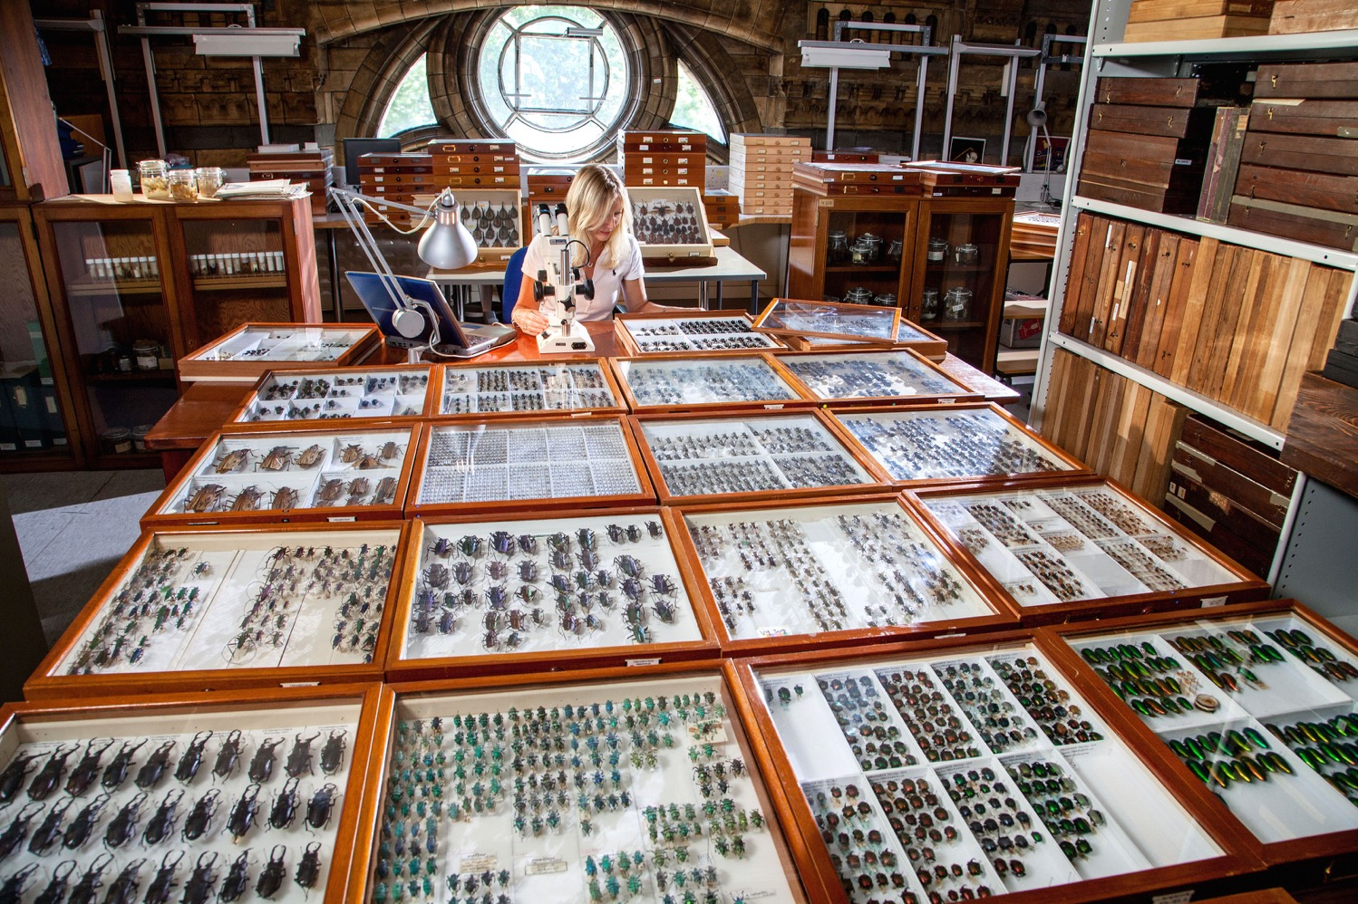
Converting labels and physical specimens to data
Notes:
https://www.flickr.com/photos/nhm_beetle_id/15930177695

Slide 8
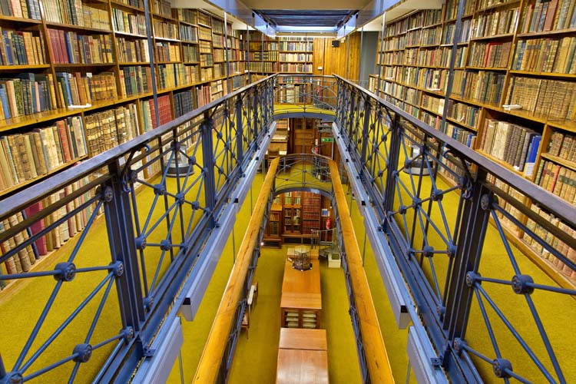
Converting text and images to data (scanning books)
Notes:
https://www.nhm.ac.uk/content/dam/nhmwww/business-services/filming/Tring%20-%20Rothschild%20Library%202.jpg

Slide 9
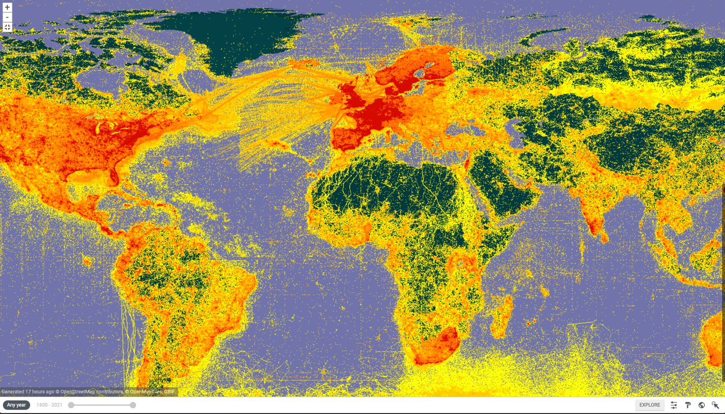
1.6 billion digitized species records gbif.org
Notes:
https://gbif.org

Slide 10
Digitalising: what new things does digital enable us to do?

Slide 11
Occurrences: what, when, and where
Notes:
https://www.flickr.com/photos/nhm_beetle_id/15930177695

Slide 12



Occurrences: what, when, and where
Digitalising: phone as sensor

Slide 13
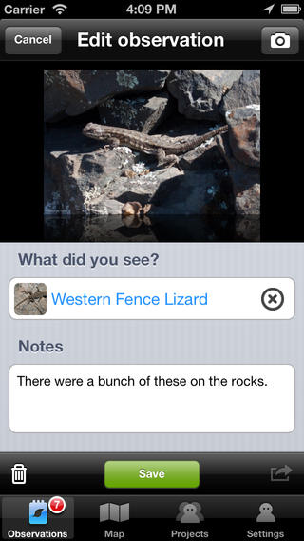
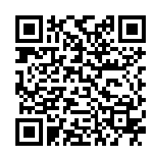
iNaturalist
Free iOS and Android app to take and upload images of organisms to inaturalist.org

Slide 14
Occurrences: what, when, and where
?

Slide 15
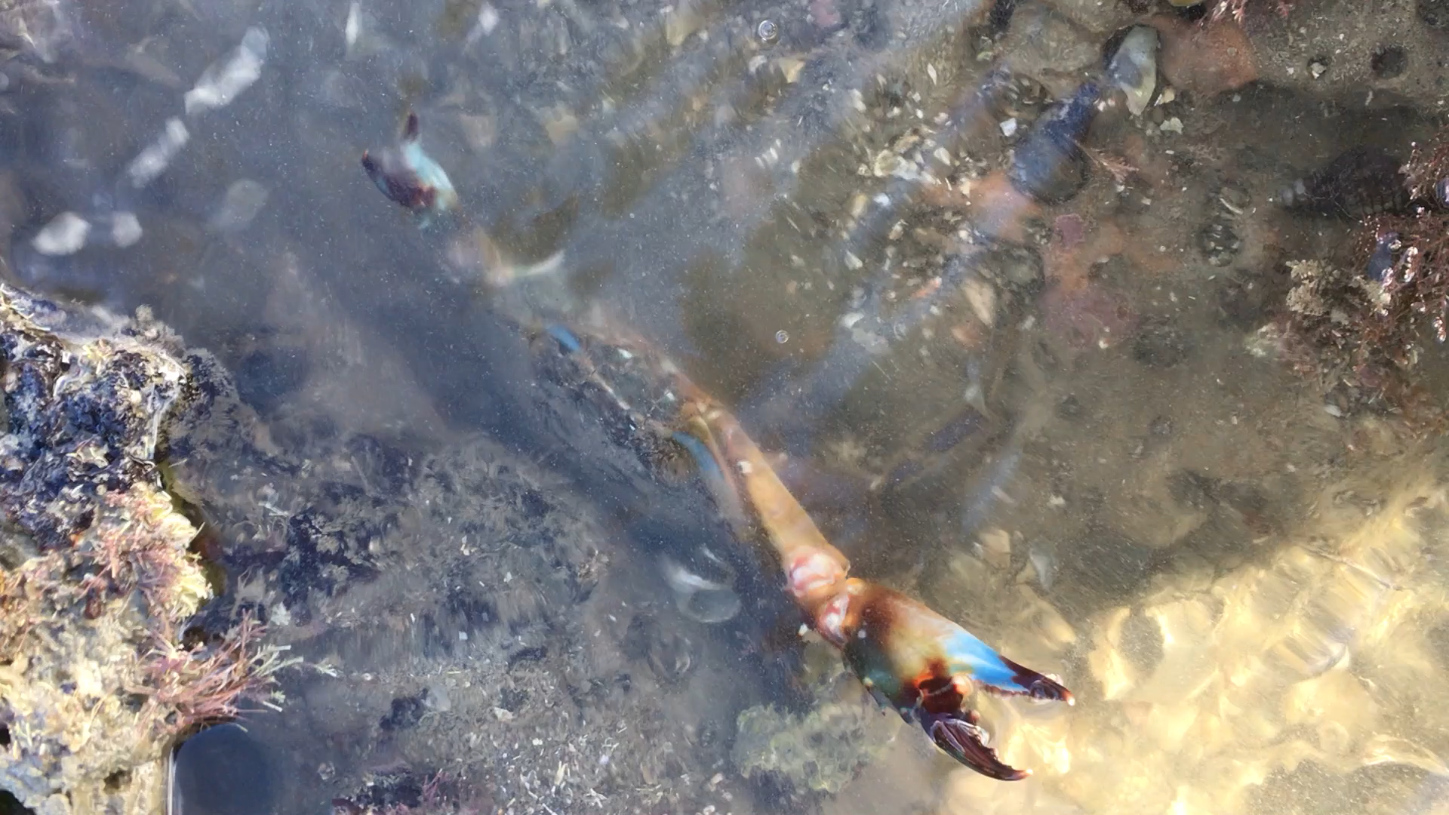
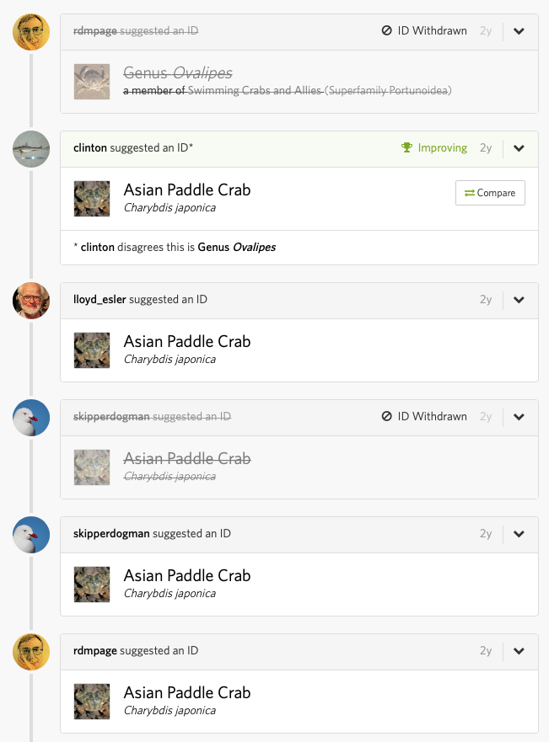
Ask the crowd…

Slide 16
iNaturalist has a millions of images that are labelled with species names… what could they do with this?

Slide 17
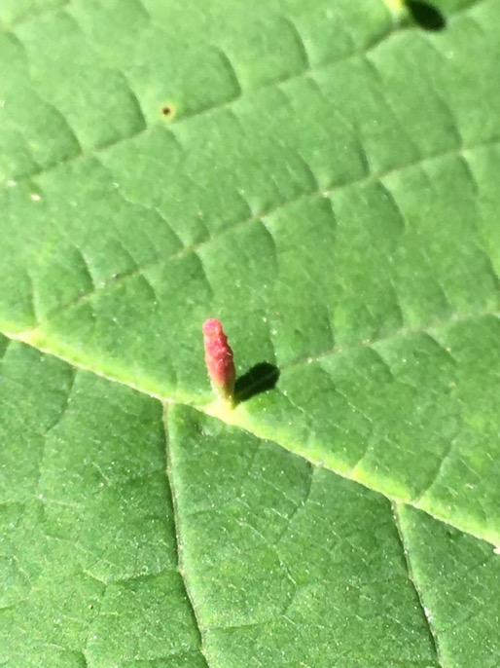
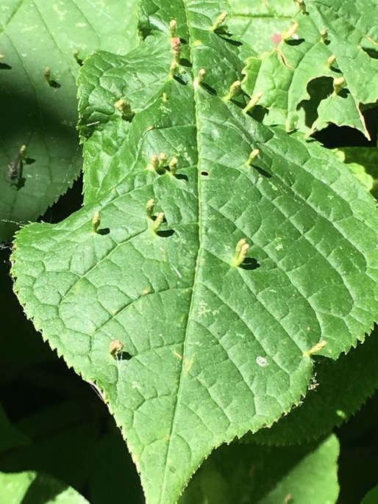

Slide 18

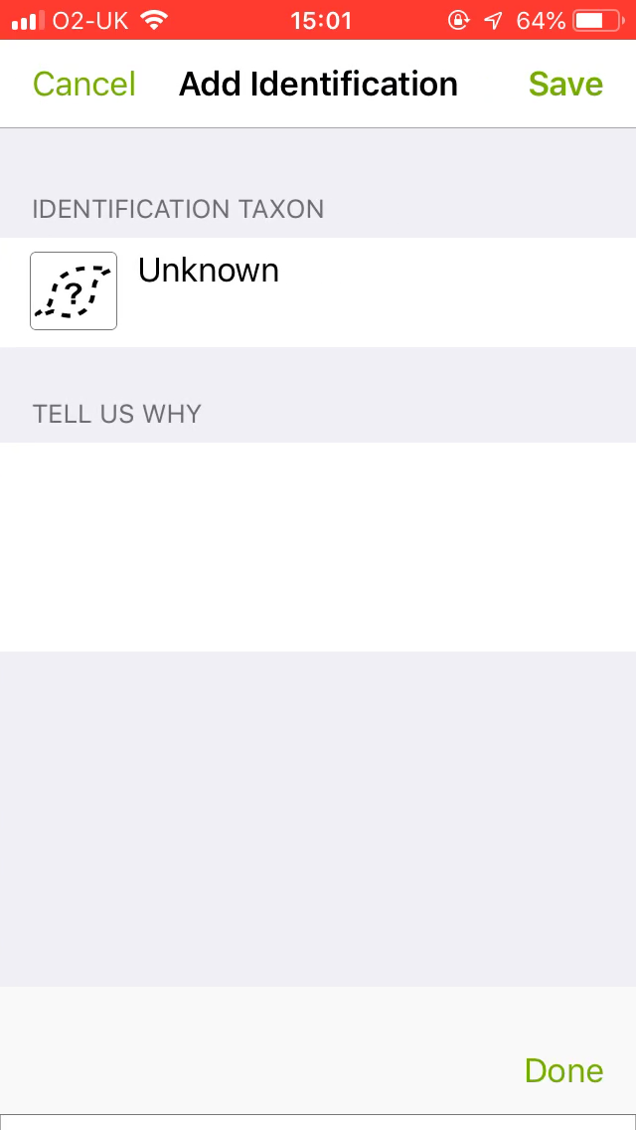
Ask the machine…

Slide 19
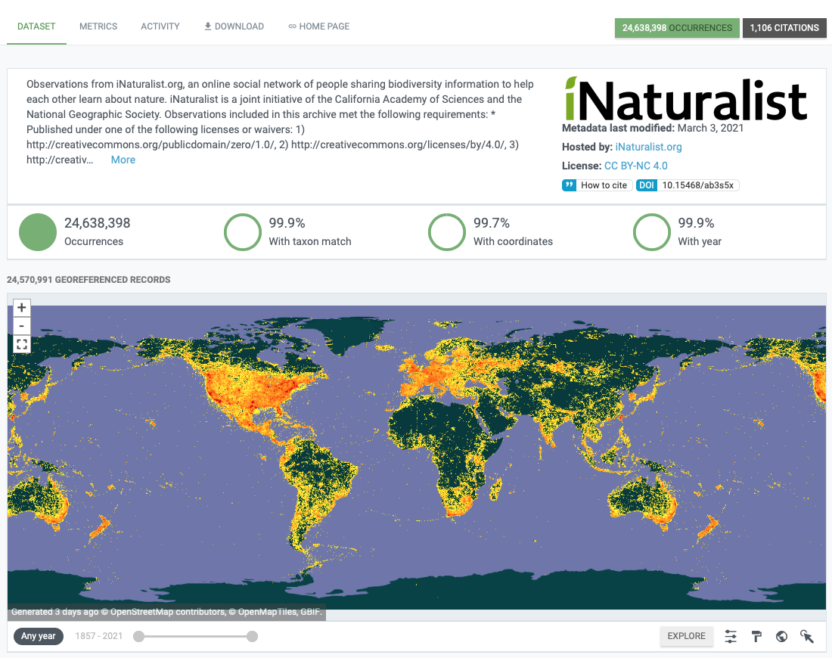
GBIF.org
24.6 million
occurrences
1,106 citations
Notes:
https://www.gbif.org/dataset/50c9509d-22c7-4a22-a47d-8c48425ef4a7

Slide 20
Digitising and digitalising
Biodiversity informatics is digitizing museums, herbaria, the living world, publications, data sets, sound recordings, anything to do with life
New digital tools such as DNA sequencing, GPS, crowd sourcing, machine learning, knowledge graphs changing how we study biodiversity
Challenges including visualizing that information in space and time (e.g., maps, trees, networks), and linking information together

Slide 21
Linking biodiversity data together

Slide 22
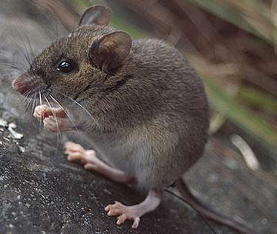
Apomys datae

Slide 23
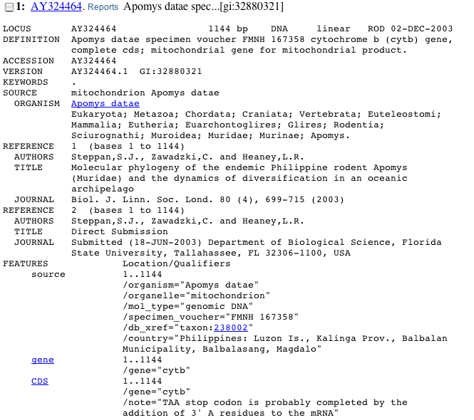

Slide 24
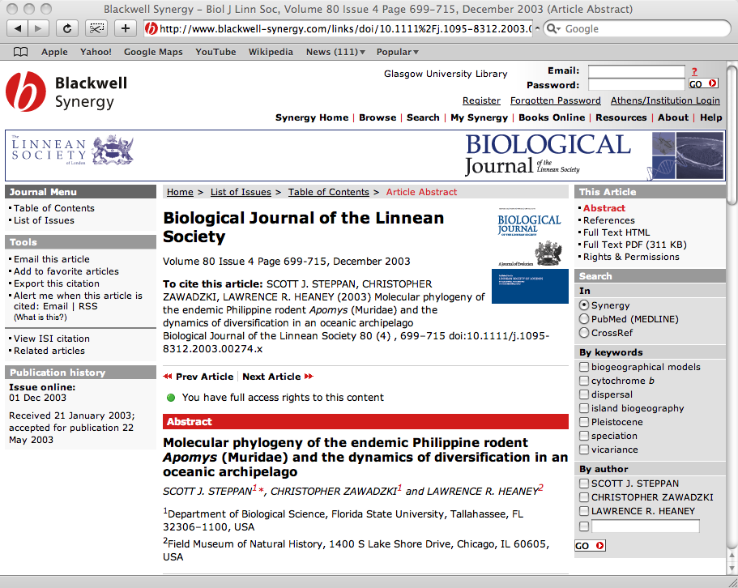

Slide 25
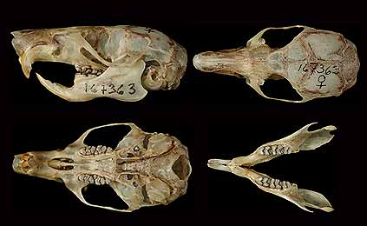
Apomys specimen

Slide 26
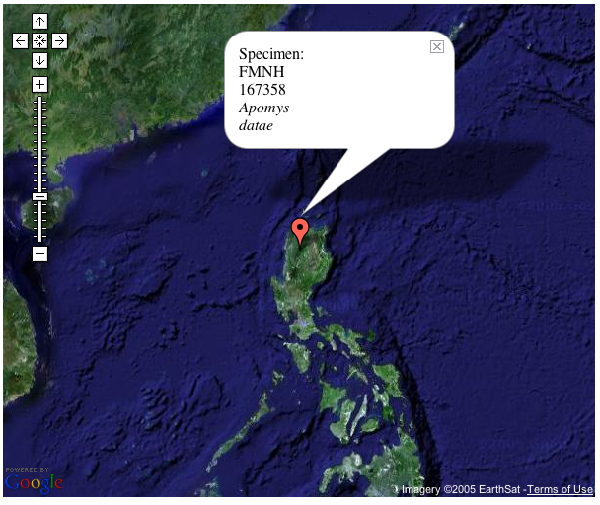

Slide 27
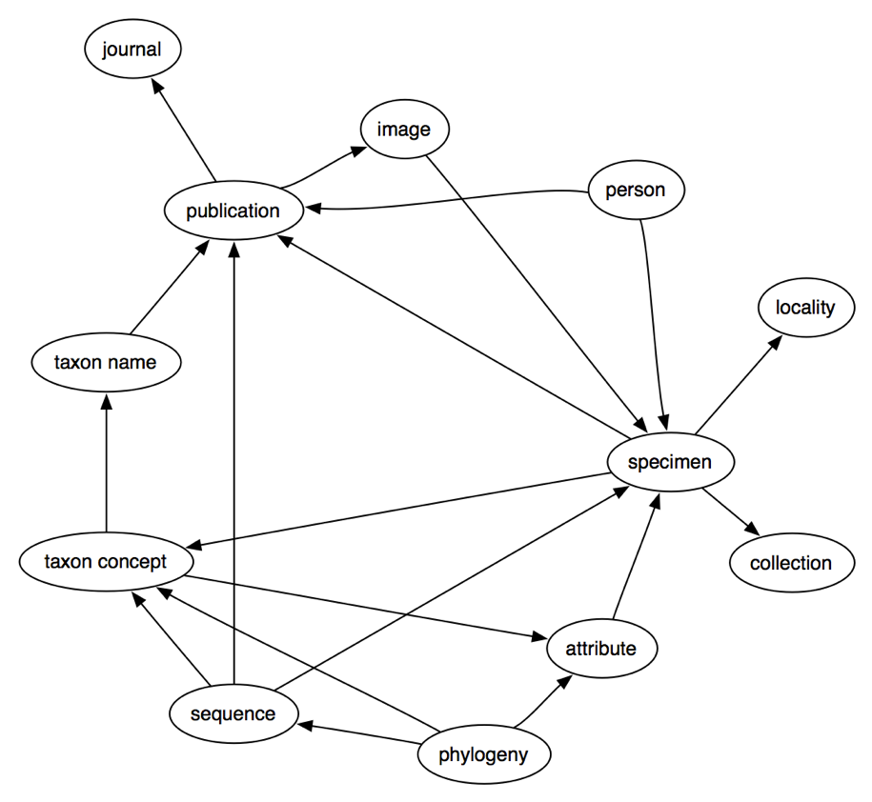





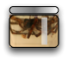
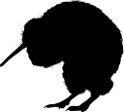


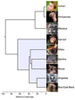

Slide 28
Our questions span multiple databases (“paths” in network)

Slide 29
Phylogeography

Slide 30
Taxonomy

Slide 32
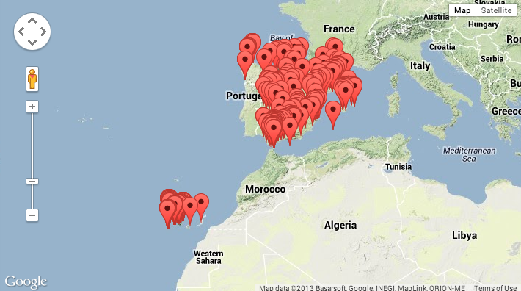
GenBank records from Spain

Slide 33
How do we integrate these data?

Slide 34
Why integrate?

Slide 35
Learn stuff we don’t know

Slide 36

There are known knowns, things we know that we know
There are known unknowns, things we now know we don’t know
But there are also unknown unknowns, things we do not know we don't know

Slide 37
knowns
unknowns
known
unknown

Slide 38
Things we know …without knowing that we know

Slide 39
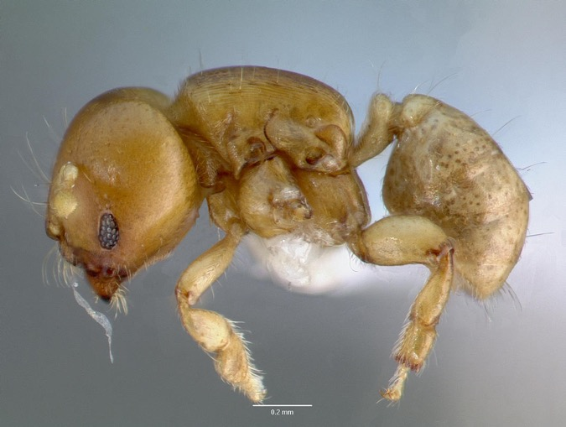
Melissotarsus insularis
Notes:
This ant illustrates a case where three different data source (NCBI, AntWeb, journal supplementary material) are needed to discover that, in fact, GenBank has sequences for this ant.

Slide 40


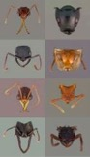
1
Melissotarsus insularis
no hit
Melissotarsus insularis
CASENT0107663-D01
CASENT0107663-D01
DQ176312
DQ176312
Melissotarsus sp. BLF m1
=
Melissotarsus sp. BLF m1
Melissotarsus insularis
Notes:
If you search NCBI for “Melissotarsus insularis” you find nothing. If you search AntWeb you find some specimens, one of which is CASENT0107663-D01. In the Phils Trans barcoding paper the supplementary material (also online in BoLD) shows that CASENT0107663-D01 has been sequenced, yielding a COI sequence with accession number DQ176312. If you go back to GenBank and look up the accession number you discover the taxon “Melissotarsus sp. BLF m1”, which must be the same as Melissotarsus insularis. Hence, GenBank should actually say “yes, I have information on Melissotarsus insularis”. There is latent knowledge in these data sources that we miss if they remain in ignorance of each other.

Slide 41
No one source has all the answers

Slide 42
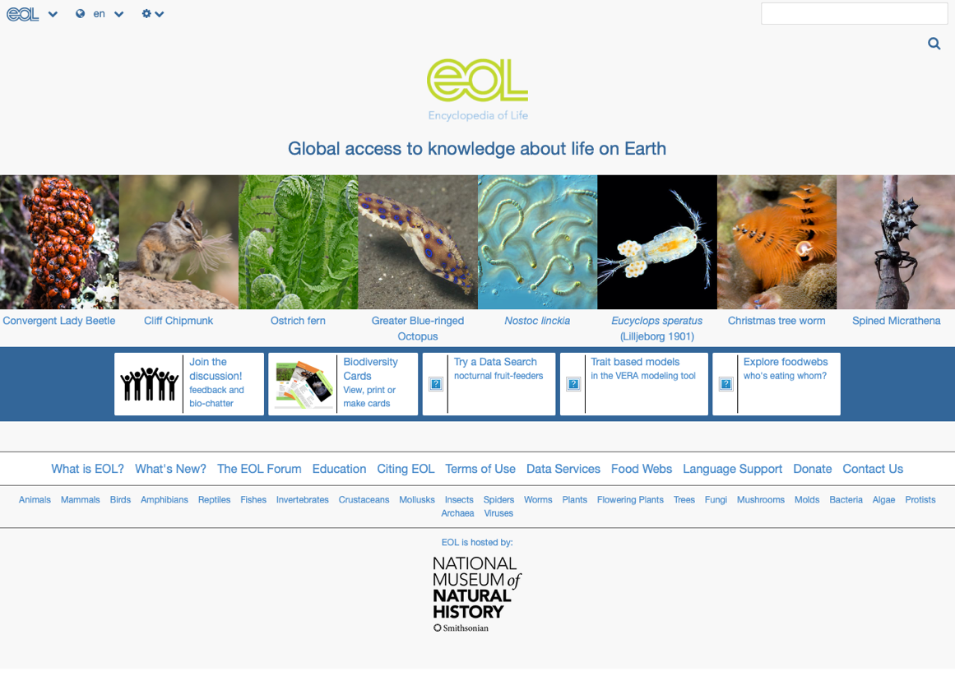
Notes:
http://www.eol.org

Slide 43

Single source of data (can we go to once site and find everything we need?)

Slide 44
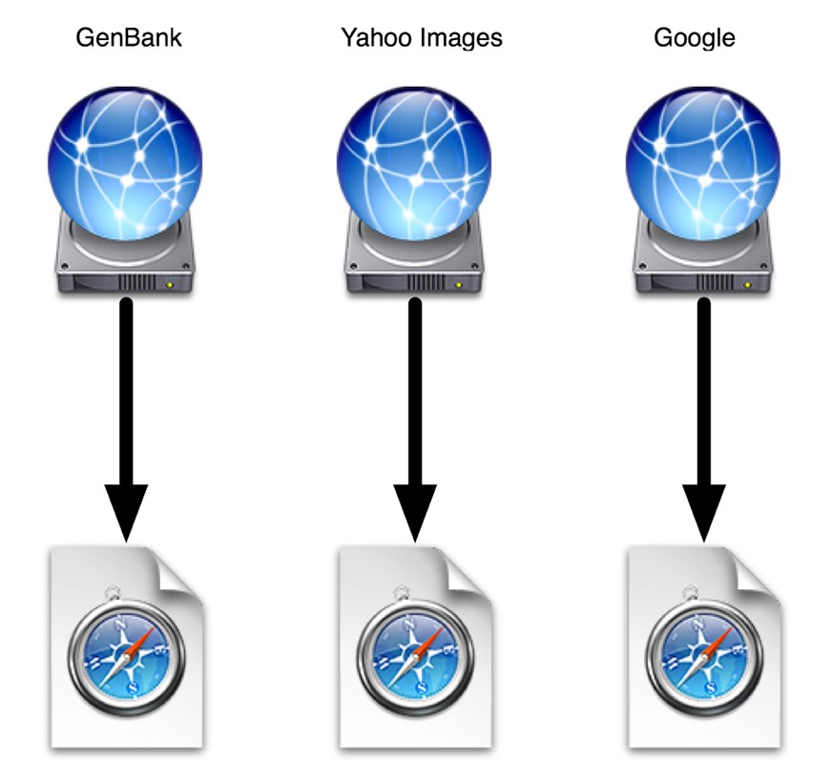
Multiple sources (we have to visit each one to get a part of the story)

Slide 45
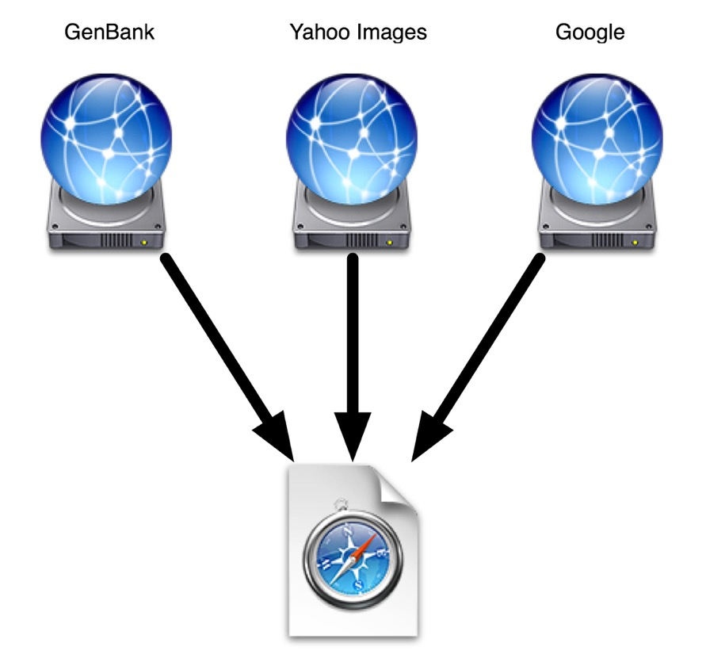
Combine sources (can we automate querying lots of different sources?)

Slide 46
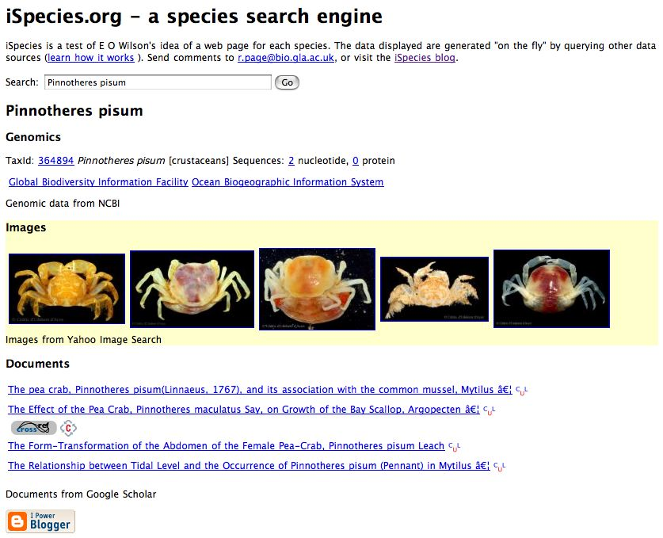
ispecies.org
Notes:
https://ispecies.org

Slide 47
Linking
Finding information about organisms
Linking together in “mashups”

Slide 48
Geography

Slide 49
1.6 billion digitized species records gbif.org

Slide 50

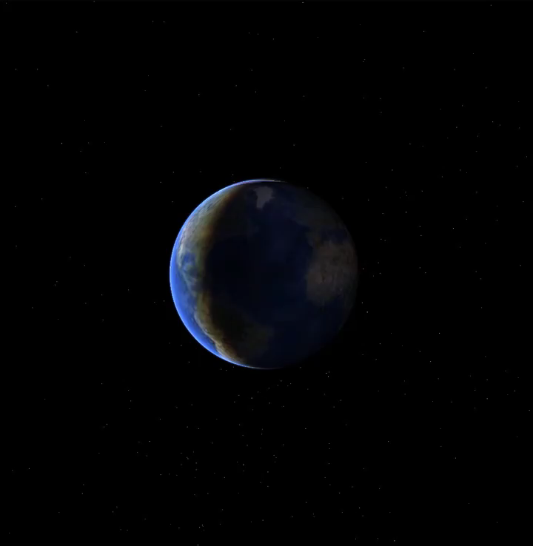
@rdmpage
Notes:
http://iphylo.blogspot.com/2007/06/earth-not-flat-official.html

Slide 51

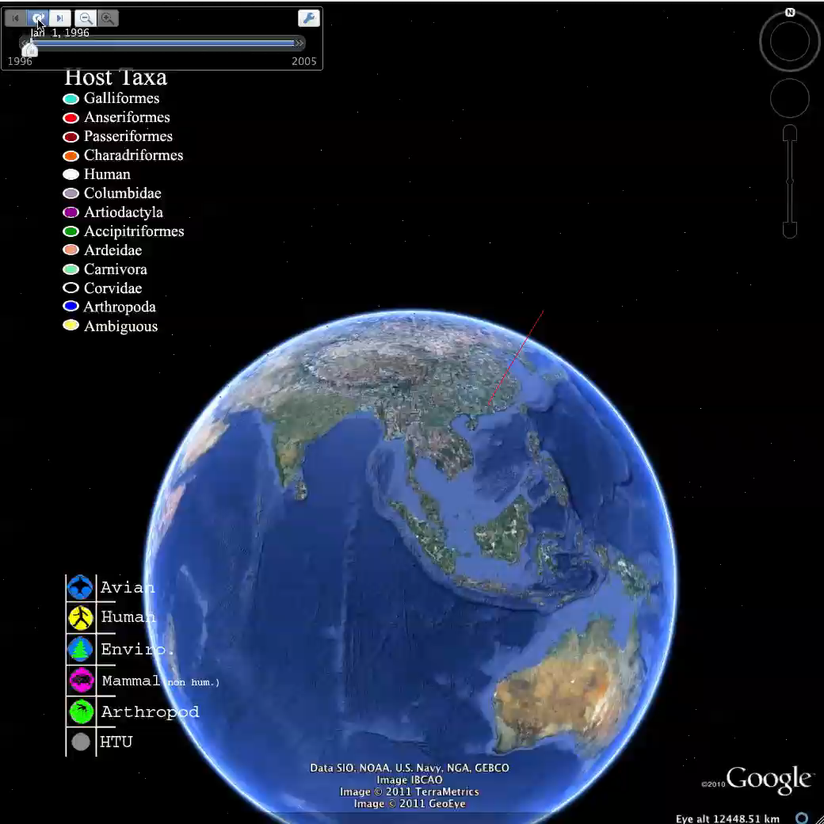
@andrewxhill
Notes:
http://systbio.org/?q=node/184, see http://dx.doi.org/10.1080/10635150701266848

Slide 52
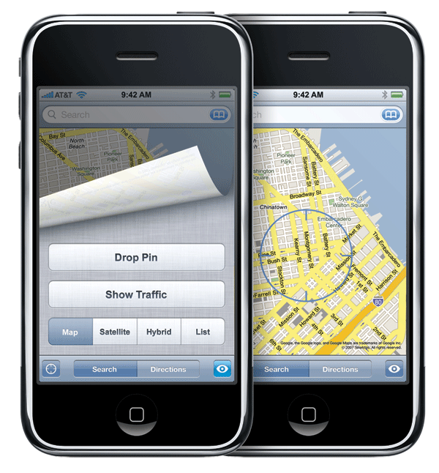

Slide 53
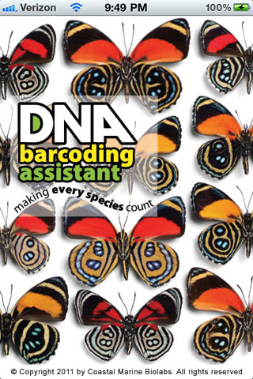
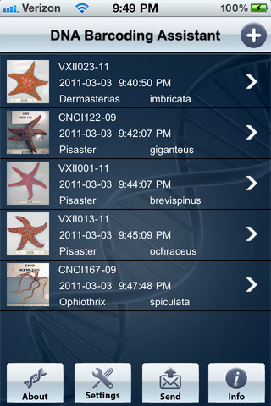

Slide 54
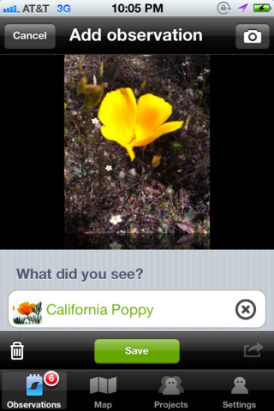
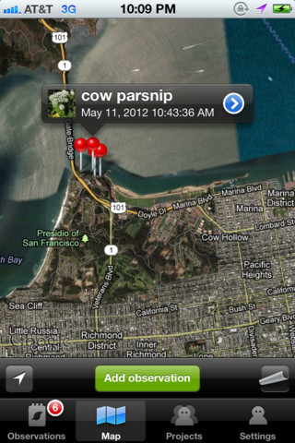
iNaturalist

Slide 55
Geography
How to make maps
Problems with geographic data
Species distributions
Geophylogenies

Slide 56
Taxonomy

Slide 57
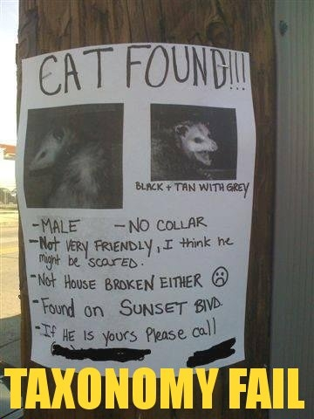

Slide 58
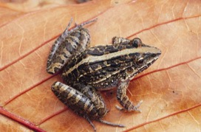
Names can change… Leptodactylus fuscus (Schneider)
Rana fusca Schneider
1802 Rana typhonia Sonnini & Latreille
1803 Rana typhonia Daudin
1824 Rana sibilatrix Wied
1826 Leptodactylus typhonius Fitzinger
1841 Cystignathus typhonius Dumeril & Bibron
1843 Leptodactylus typhonius Fitzinger
1858 Cystignathus fuscus Günther
1882 Leptodactylus typhonius Boulenger
1927 Leptodactylus sibilatrix Müller
1935 Leptodactylus sibilatrix Parker
1968 Leptodactylus fuscus Heyer

Slide 59
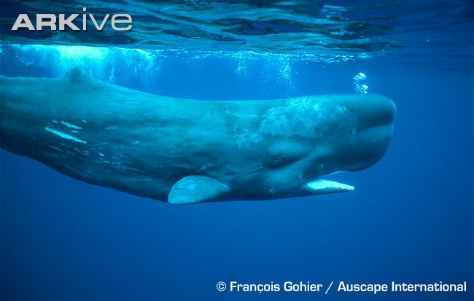

Slide 60
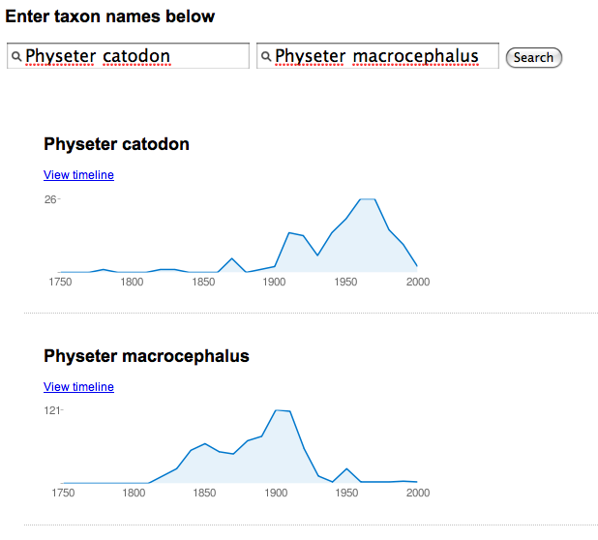
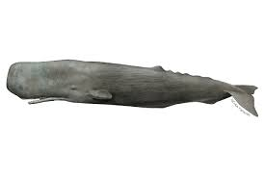

Slide 61
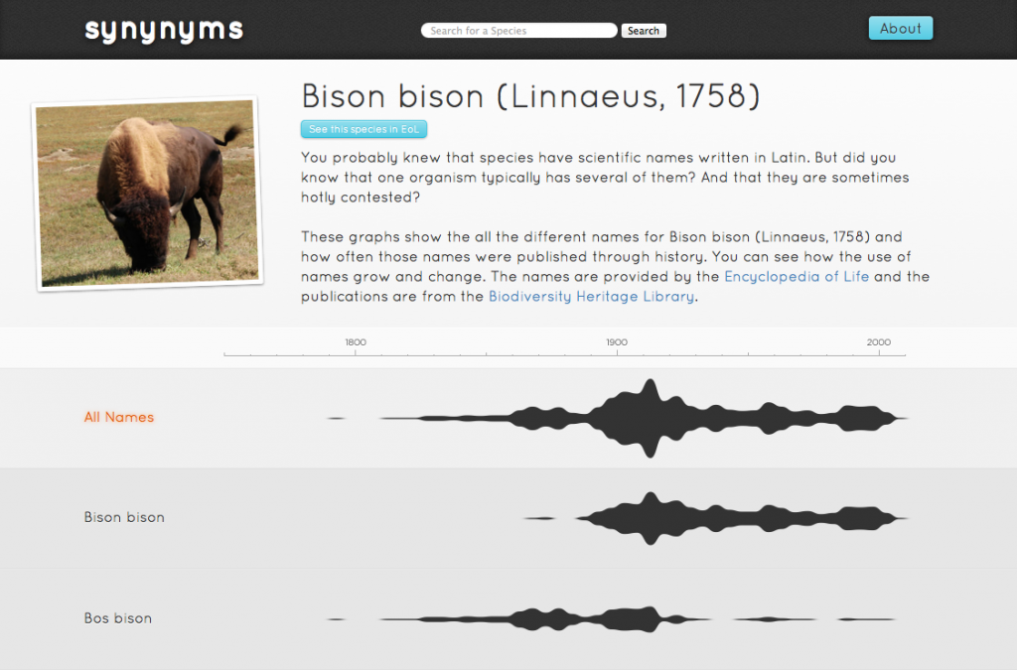

Slide 62

Taxonomy as a source of data

Slide 63
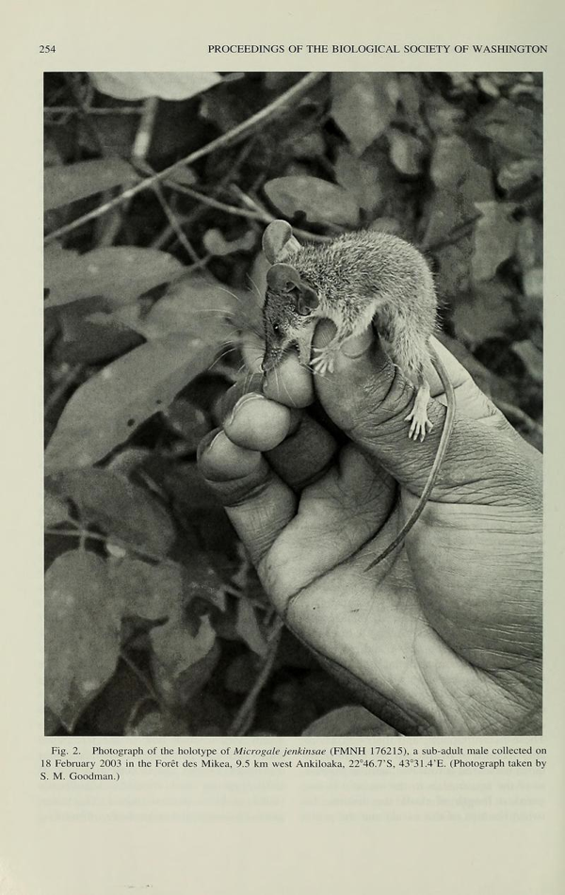

Slide 64
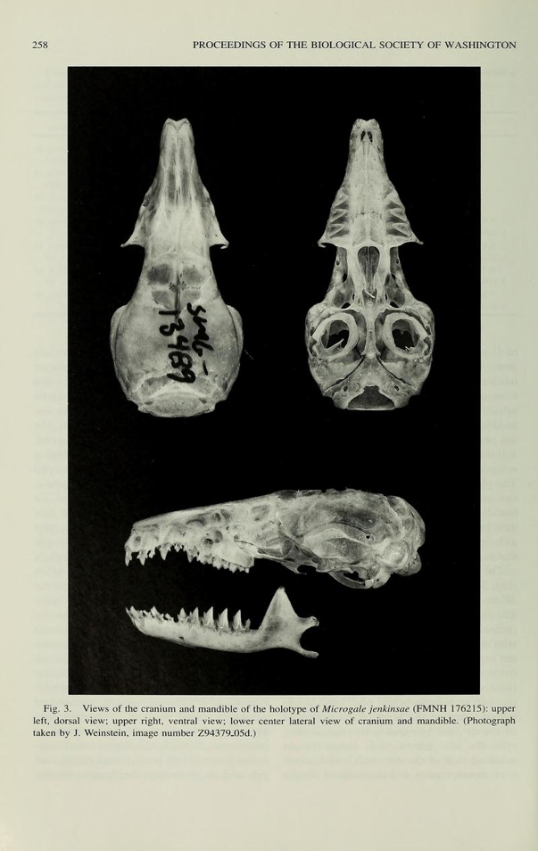

Slide 65
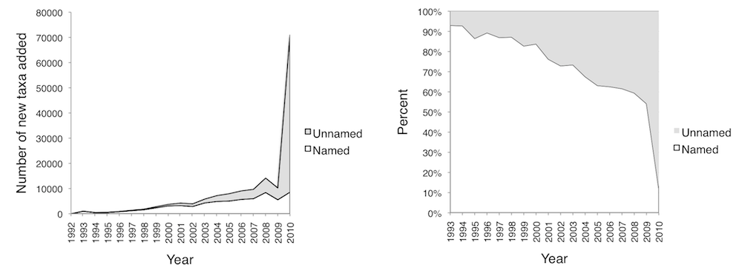
“Dark taxa”
Many DNA sequences in GenBank do not have proper scientific names

Slide 66
Classification

Slide 67
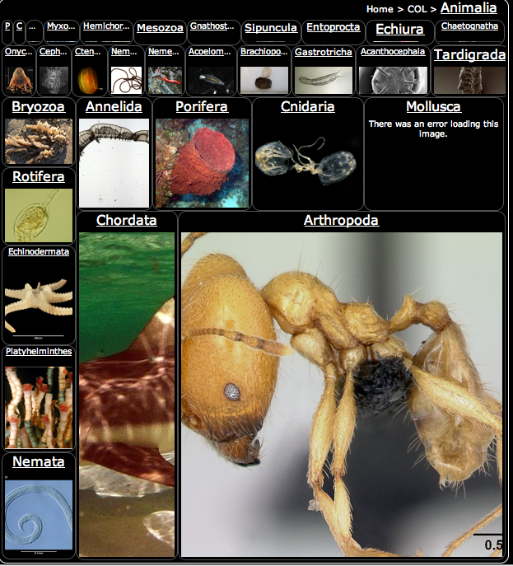
http://synthesis.eol.org/media/treemap/

Slide 68

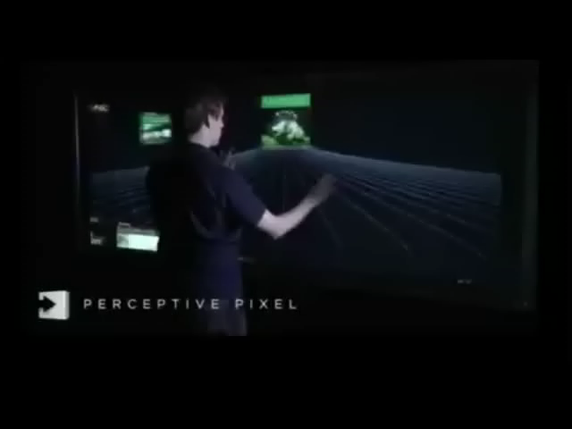
@kzelnio
Think how great of a tool that could be at museums on a large flat screen at 4 year old height.
Notes:
http://www.perceptivepixel.com/ and http://iphylo.blogspot.com/2008/08/perceptive-pixel-taxonomy-demo.html

Slide 69
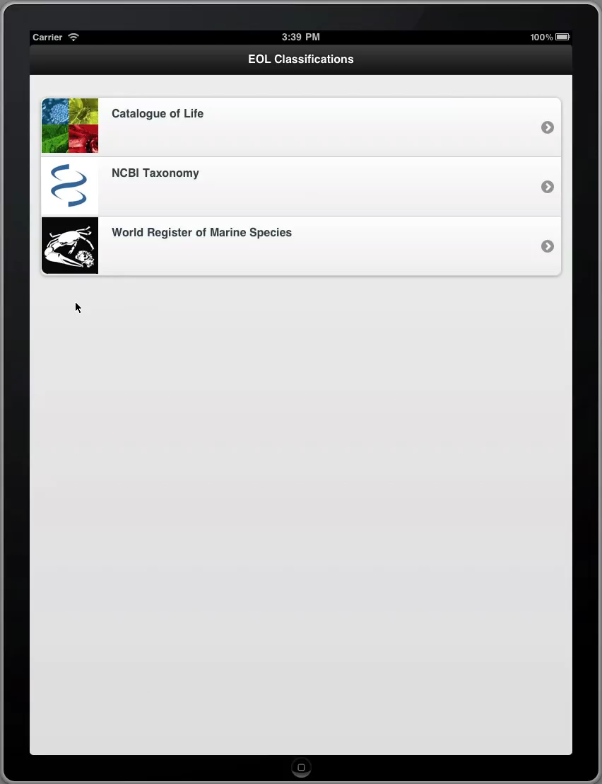

Slide 70
Taxonomy
Names
Synonyms
Classifications
Visualisation

Slide 71
Phylogeny

Slide 72
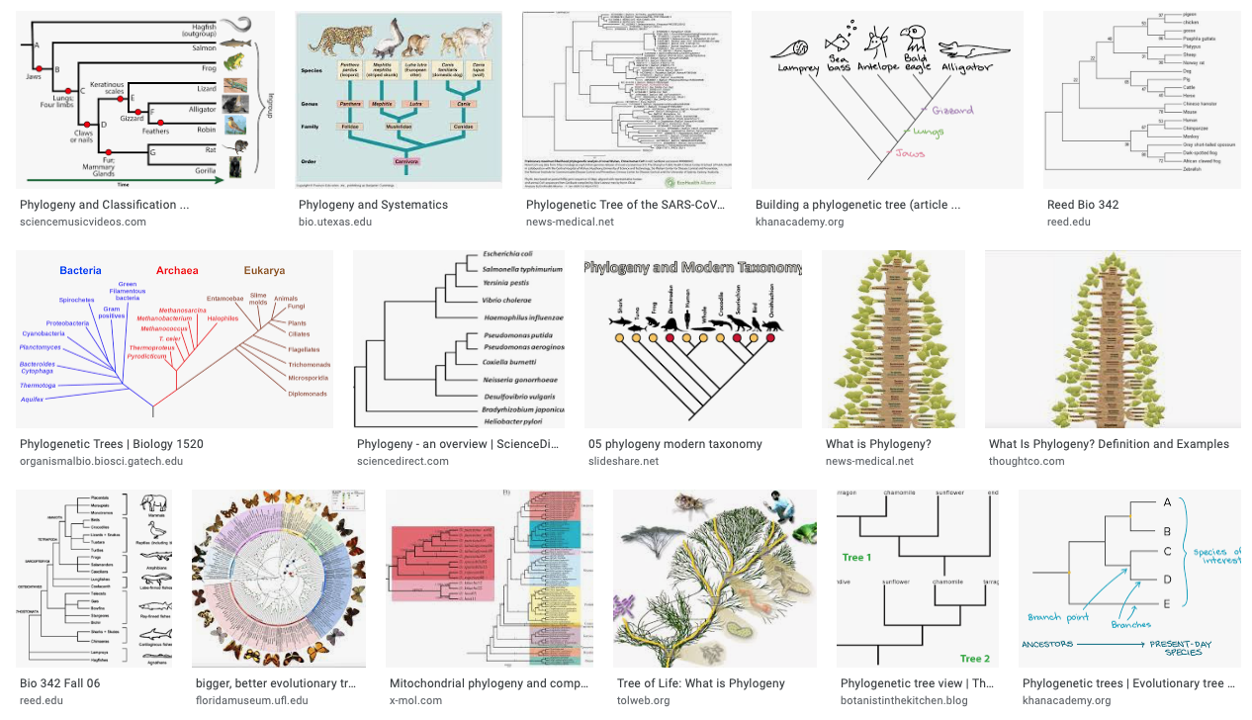

Slide 73
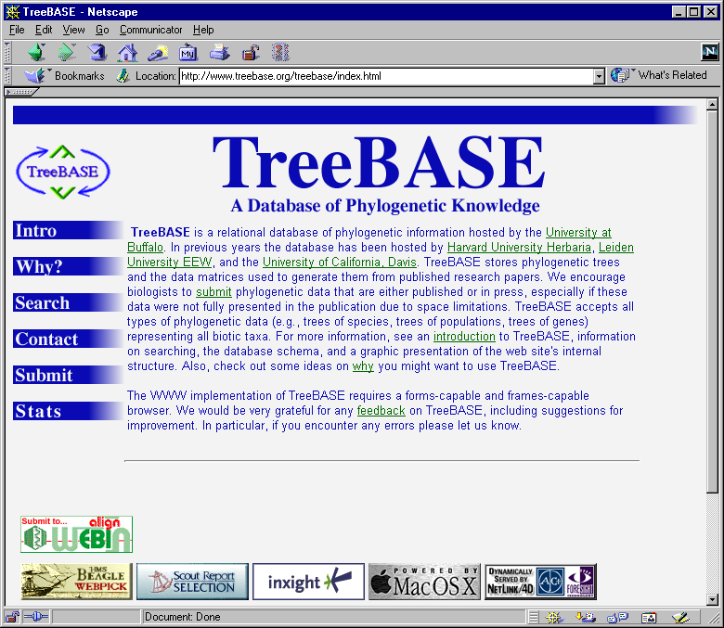

Slide 74
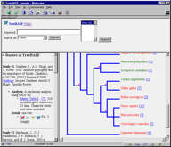
Rate of growth of phylogenetic knowledge
Number of papers with “molecular” and “phylogeny” in Web of Science
Number of studies in TreeBASE

Slide 75
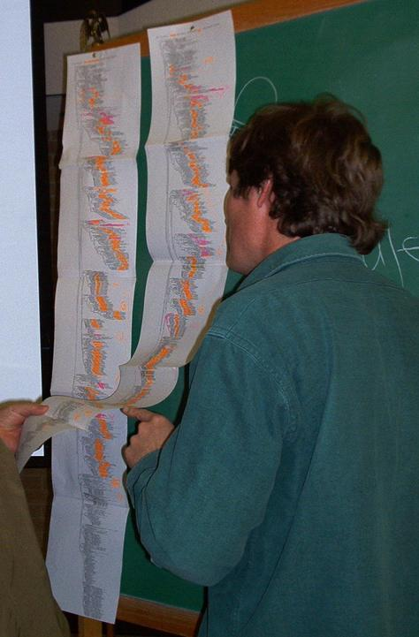

Slide 76


Slide 77


@dr_pi
Notes:
Petra Isenberg, see “Interactive tree comparison for co-located collaborative information visualization” http://www.ncbi.nlm.nih.gov/pubmed/17968069 and http://innovis.cpsc.ucalgary.ca/Research/CollaborativeTreeComparison

Slide 78
Phylogeny
Finding a phylogeny for a group of organisms
Displaying on the web (visualisation)

Slide 79
Data mining and linking

Slide 80


Slide 81

Text mining

Slide 82

Morphological and molecular description of Haematoloechus meridionalis n. sp. (Digenea: Plagiorchioidea: Haematoloechidae) from Rana vaillanti brocchi of Guanacaste, Costa Rica
Halipegus eschi n. sp. (Digenea: Hemiuridae) in Rana vaillanti from Guanacaste Province, Costa Rica
Haematoloechus danbrooksi n. sp. (Digenea: Plagiorchioidea) from Rana vaillanti from Los Tuxtlas, Veracruz, Mexico

Slide 83

What do crustaceans live on?
Arthropods
Fungi
Vertebrates
Green
plants
Bacteria

Slide 84

What do insects live on?
Arthropods
Fungi
Vertebrates
Green
plants
Bacteria

Slide 85
Knowledge Graph
Entities have identifiers and are linked together in a network of relationships.

Slide 86
Data mining
Extracting information from the literature
Extracting information from databases
Connecting things together (Knowledge Graphs)

Slide 87
The End

Slide 88
Exercises

